Slide 1
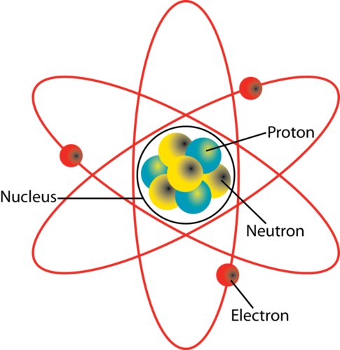
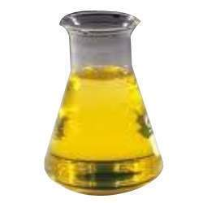
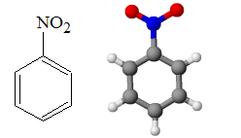
SYLLABUS
CHEMISTRY
CLASS XI

Slide 2
CONTENTS
INTRODUCTION
TEXT BOOKS
LINK WITH CLASS 10
COURSE STRUCTURE (THEORY)
COURSE STRUCTURE (PRACTICAL)
QUESTION PAPER PATTERN
SAMPLE PAPER (General Instructions)

Slide 3
INTRODUCTION
In class 11th you will study the concepts of fundamental chemistry.
While studying try to find applications of the topic that will help you in understanding the topic better as you could relate it to physical world.
11th can be considered the advanced class of the 9th. You will study in depth about the concepts which you have studied in 9th and 10^{th.}

Slide 4
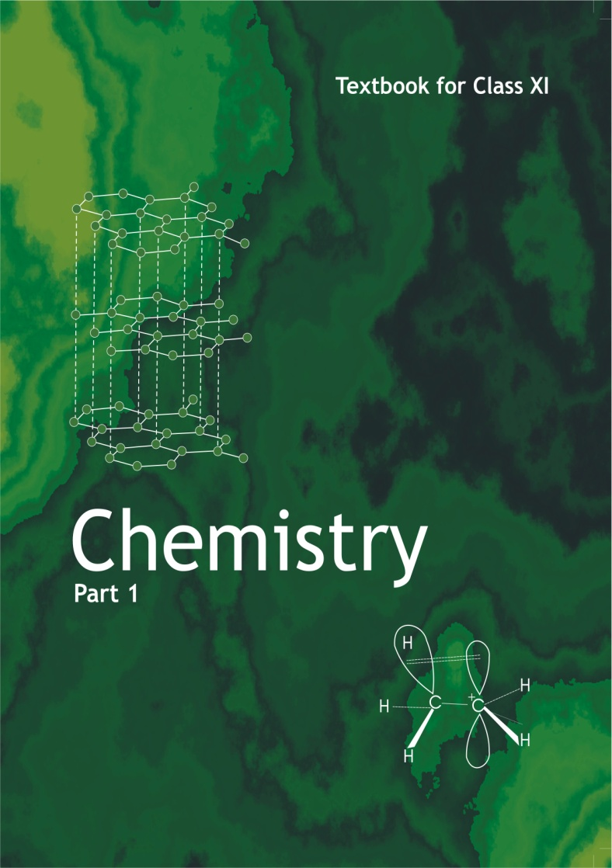
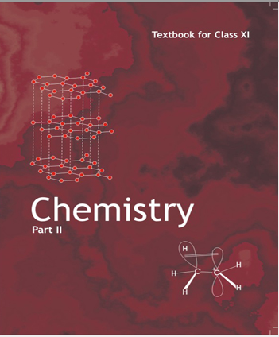
Text Books

Slide 5
LINK WITH CLASS 9 & 10
CLASS 9 | CLASS 10 | CLASS 11
Mole concept | Chemical reactions , Balancing Chemical equations | Basic Concepts of Chemistry
Atoms and molecules |  | Structure of Atom
 | Periodic classification of elements | Classification of Elements & Periodicity in Properties
 | Carbon and its compounds | Hydrocarbons
Ionic compounds | Ionic and Covalent compounds | Chemical Bonding and Molecular Structure

Slide 6
Theory
Practical
70 M
30 M
Notes:
Colouring are food additives like dyes, pigments or other substances which impart colours to the food.

Slide 7
COURSE STRUCTURE (THEORY)
UNIT | CHAPTER | MARKS
I | Basic Concepts of Chemistry | 11
II | Structure of Atom
III | Classification of Elements & Periodicity in Properties | 4
IV | Chemical Bonding and Molecular Structure | 21
V | States of Matter: Gases and Liquids
VI | Thermodynamics
VII | Equilibrium

Slide 8
COURSE STRUCTURE (THEORY) Cont…
UNIT | CHAPTER | MARKS
VIII | Redox Reactions | 16
IX | Hydrogen
X | s-Block Elements
XI | Some p-Block Elements
XII | Organic Chemistry: Basic Principles & Techniques | 18
XIII | Hydrocarbons
XIV | Environmental Chemistry
Total |  | 70

Slide 9
COURSE STRUCTURE (PRACTICAL)
S. No. | PRACTICAL | MARKS
1 | Volumetric Analysis | 8
2 | Salt Analysis | 8
3 | Content based Experiment | 6
4 | Project Work | 4
5 | Class Record + Viva | 4
Total |  | 30

Slide 10
Investigatory Project
Checking the bacterial contamination in drinking water by testing sulphide ions.
Study of the methods of purification of water.
Testing the hardness, presence of iron, fluoride, chloride etc. depending upon the regional variation in drinking water and the study of causes of presences of these ions above permissible limit (if any).
Investigation of the foaming capacity of different washing soaps and the effect of addition of sodium carbonate on them.
Study of the acidity of different samples of the tea leaves.
Determination of the rate of evaporation of different liquids.
Study of the effect of acids and bases on the tensile strength of fibers.
Analysis of fruit and vegetable juices for their acidity.

Slide 11
QUESTION PAPER PATTERN
TYPE OF QUESTION | MARKS PER QUESTION | TOTAL NO. OF QUESTIONS | TOTAL MARKS
VSA | 1 | 5 | 5
SA-1 | 2 | 5 | 10
SA-2 | 3 | 12 | 36
Value Based | 4 | 1 | 4
LA | 5 | 3 | 15
TOTAL |  | 26 | 70

Slide 12
SAMPLE PAPER
General Instructions:
All questions are compulsory.
Marks for each question are indicated against it.
Question numbers 1 to 5 are very short answer questions, carrying 1 mark each. Answer these in one word or about one sentence each.
Question numbers 6 to 10 are short answer questions, carrying 2 marks each. Answer these in about 30 words each.
Question numbers 11 to 22 are short answer questions carrying 3 marks each. Answer these in about 40 words each.
Question number 23 is value based question and carries 4 marks.
Question numbers 24 to 26 are long answer questions carrying 5 marks each. Answer these in about 70 words each.
Use log tables, if necessary. Use of calculator is not permitted.

Slide 13
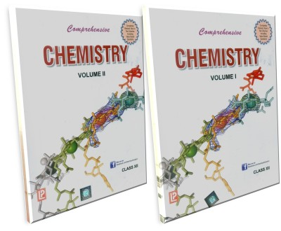
Reference Books Comprehensive Chemistry XI Pradeep’s New course Chemistry XI Modern ABC of Chemistry XI

Slide 14
THANK YOU
ARUNA CHAUDHARY

